Slide 1
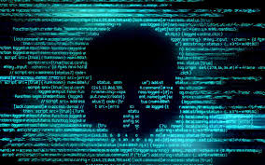
Computer Viruses
Leandro Jorge Fernández Vega

Slide 2

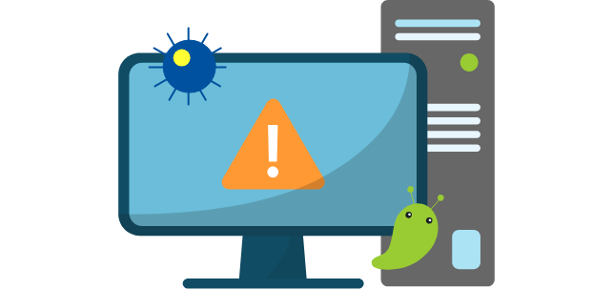
Definition
Programs designed to infect and damage systems.

Slide 3

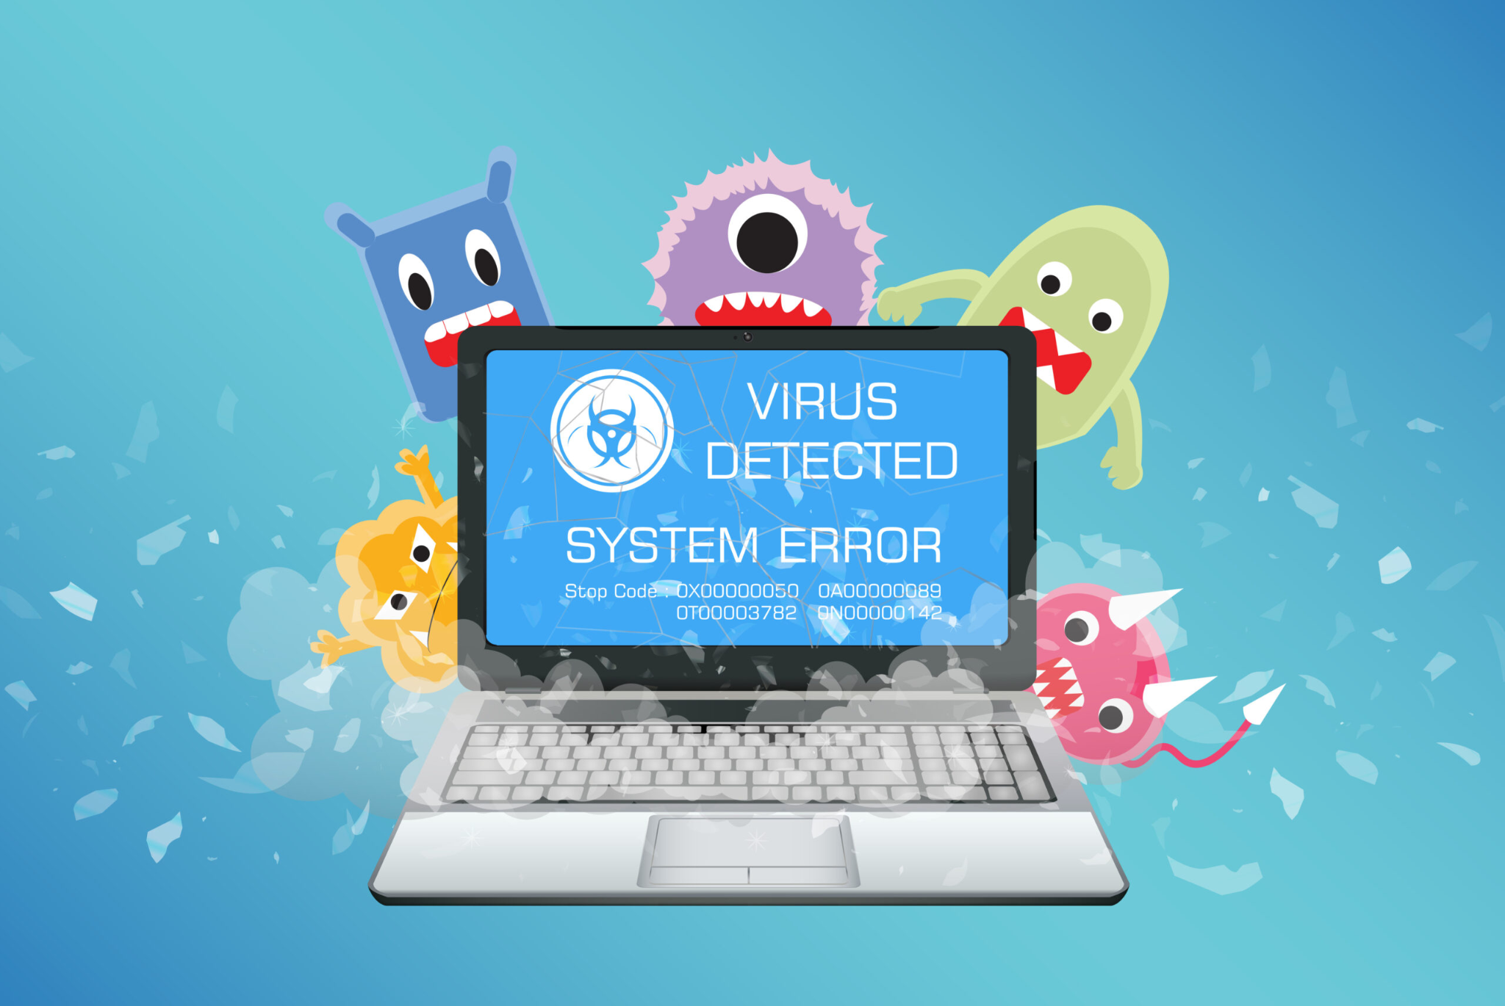
Types of Viruses
Program Virus
Worms
Trojans
Ransomware
Spyware
Adware

Slide 4



Program Virus
A program virus is a type of malware that attaches itself to executable files and spreads when the infected program is run.
Infects application software and system files.
Activates when the host program is executed.
It can corrupt, modify, or delete files.
Spreads to other programs on the same system.

Slide 5
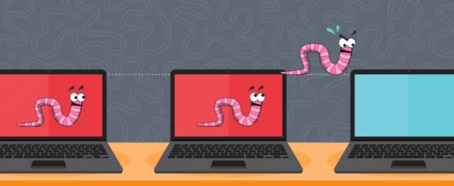
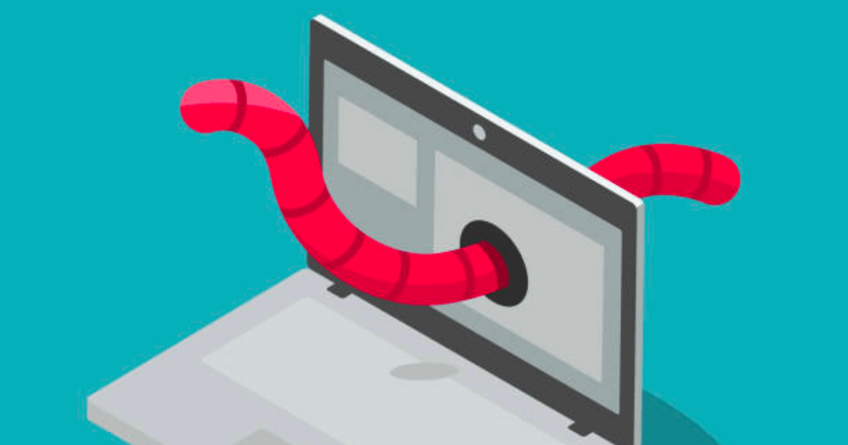
Worms
A worm is a type of malware that replicates itself and spreads across networks without needing a host file or user action.
Self-replicates and spreads rapidly.
Exploits network vulnerabilities.
Can slow down or crash systems by consuming bandwidth and resources.
Often used to install additional malware.

Slide 6

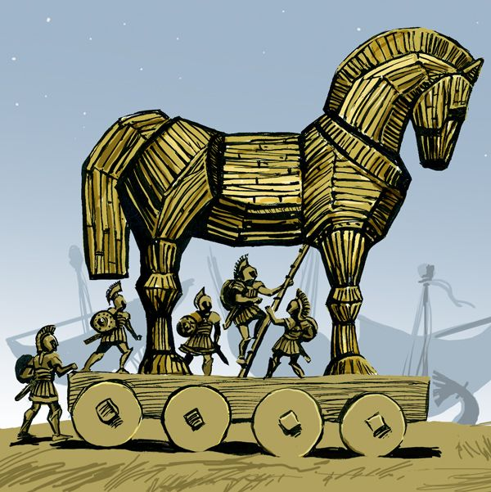

Trojans
A Trojan, or Trojan Horse, is a type of malware that disguises itself as legitimate software to trick users into installing it, allowing attackers to gain control or steal data.
Opens backdoors for hackers to access the system.
Can steal sensitive information (passwords, banking data, etc.).
Often spreads through fake software downloads or phishing emails.

Slide 7

Ransomware
Ransomware is a type of malware that encrypts a victim’s files and demands payment (ransom) to restore access.
Encrypts important files, making them inaccessible.
Often spreads through phishing emails and malicious downloads.
Demands payment in cryptocurrency to avoid tracing.
Can target individuals, businesses, and even government institutions.

Slide 8


Spyware
Spyware is a type of malware that secretly gathers information about a user’s activities without their knowledge and sends it to a third party.
Runs in the background without user consent.
Collects personal data such as passwords, browsing history, and financial details.
Can slow down system performance and cause privacy breaches.
Often installed through free software, malicious websites, or phishing emails.
A good example are keyloggers, which record keystrokes to steal passwords and login credentials.

Slide 9
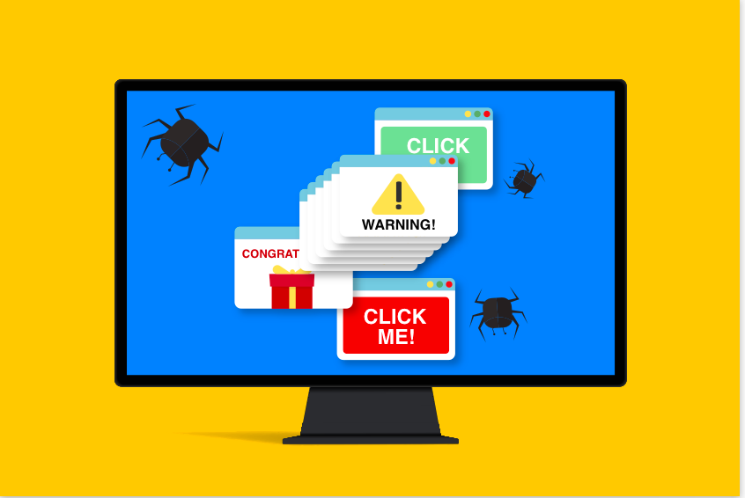
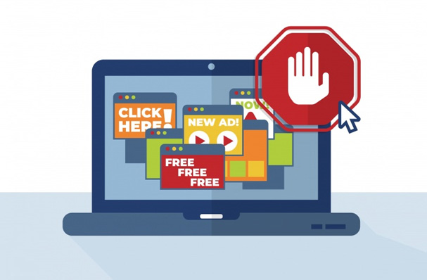
Adware
Adware is a type of software that automatically displays unwanted advertisements, often in the form of pop-ups or banners, and may track user behavior for targeted advertising.
Displays intrusive ads, often slowing down the system.
Can collect browsing history and personal data.
Often bundled with free software or fake downloads.
May redirect users to malicious websites.

Slide 10


How to Stay Protected
Use antivirus software
Keep software and operating system updated
Avoid suspicious emails and links
Use strong and unique passwords
5. Enable firewalls and network security
6. Backup important data regularly
7. Be cautious with software downloads

Slide 11

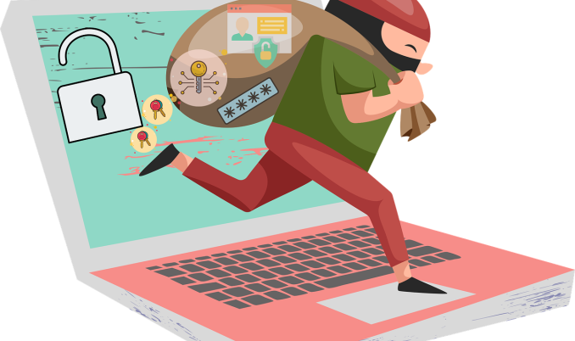
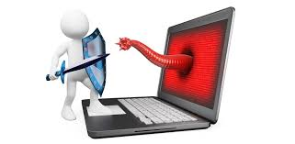
The End

